Slide 1

UNIVERSITY INSTITUTE OF ENGINEERING
COMPUTER SCIENCE ENGINEERING
Bachelor of Engineering (Computer Science & Engineering)
Subject Name: STATISTICAL METHODS USING R
Subject Code: 20SMT-460
Discrete Distribution
Mapped with CO
Prepared By:
Ms. Hardeep Kaur
DISCOVER . LEARN . EMPOWER

Slide 2
Binomial Distribution
Binomial distribution was discovered by James Bernoulli (1654-1705) in the year 1700 and was first published posthumously in 1713, eight years after his death).
Let a random experiment be performed repeatedly and let the occurrence of an event in a trial be called a success and its non-occurrence a failure. Consider a set of n independent Bernoullian trials (n being finite), in which the probability 'p' of success in any trial is constant for each trial. Then q = 1 - p, is the probability of failure in any trial.

Slide 3
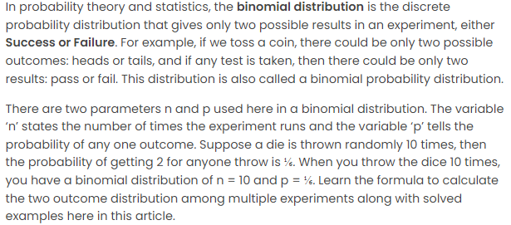

Slide 4
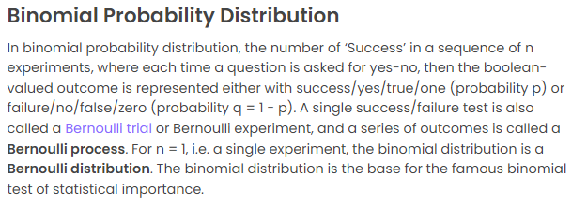

Slide 5
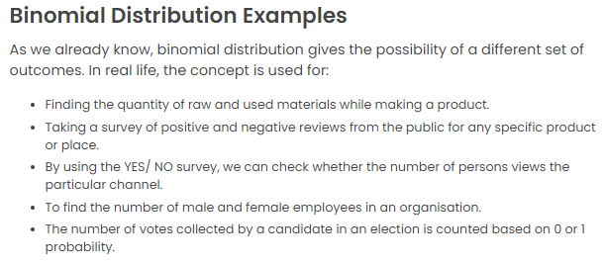

Slide 6
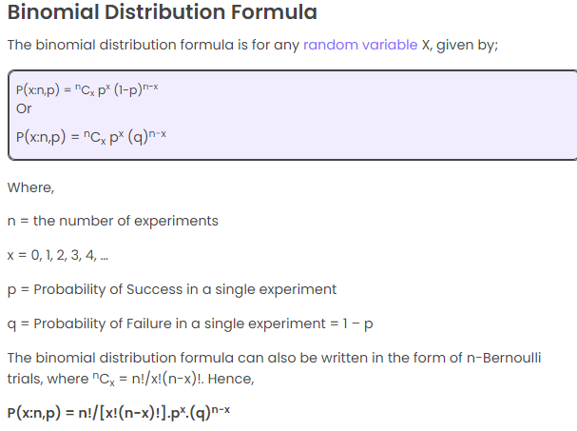

Slide 7
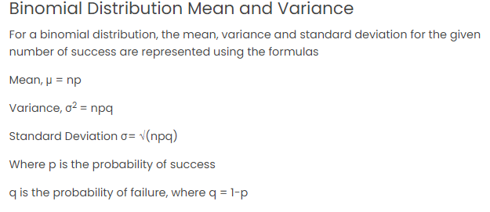

Slide 8
